Slide 1
Job Recommendation System with Candidate Evaluation
Aakanchhya Sigdel (8097/072)
Subesh Bhandari (8136/072)
Tashi Lama (8141/072)
1

Slide 2
CHAPTER 1
INTRODUCTION
2

Slide 3
1.1 Introduction
Job Recommendation System
Job seeker subsystem
Job provider subsystem
Candidate Evaluation System
Public skill testing
Private skill testing
3

Slide 4
1.2 Problem definition
For Job Seekers
Searching jobs with matching criteria
No response from recruiting company
For Job Providers
Finding right job candidate
Surfing through numerous CVs.
Tedious, time consuming and inefficient
4

Slide 5
1.3 Objectives
Recommend jobs
Evaluate job candidates
5

Slide 6
1.4 Scope of the project
For Job Seekers
get jobs recommended
search and apply for jobs
view activity on dashboard
For Job Providers
post jobs
set up tests
view job post report
6

Slide 7
1.5 Limitations
Fails to track every job seeker’s and job provider’s information
Fails to recommend jobs to user not logged in
Fails to modify testing process in system.
7

Slide 8
CHAPTER 2
RESEARCH METHODOLOGY
8

Slide 9
2.1 Literature Review
Applying Different Classification Techniques in Reciprocal Job Recommender system for considering Job Candidate Preference
Taxonomy-based Job Recommender Systems On Facebook and LinkedIn Profiles
9

Slide 10
Combining content-based and collaborative filtering for job recommendation system: A cost-sensitive Statistical Relational Learning approach
Tree-based Contextual Learning for Online Job or Candidate Recommendation with Big Data Support in Professional Social Networks
10

Slide 11
Dynamic User Profile-Based Job Recommender System
Help Me Find a Job: A Graph-based Approach for Job Recommendation at Scale
11

Slide 12
2.2 Related Study
Upwork
Mero Job
12

Slide 13
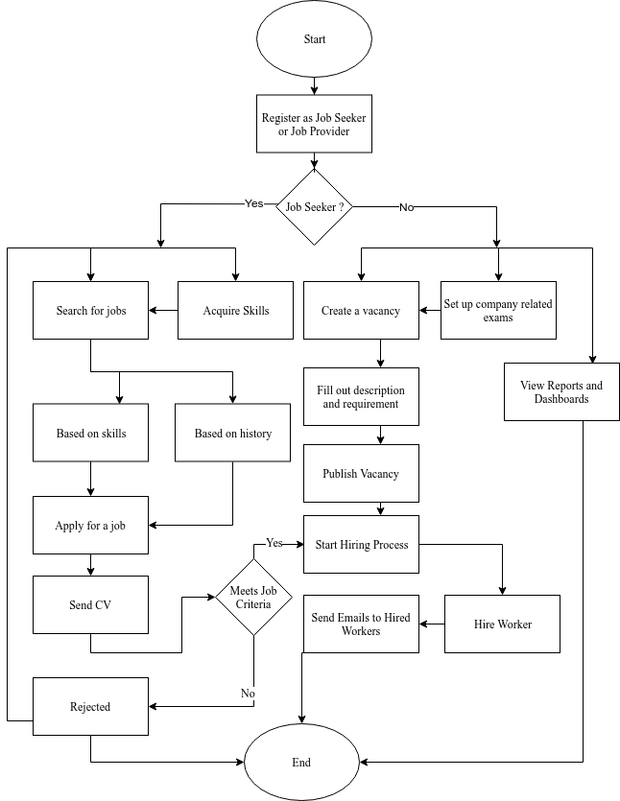
2.3 Flow Chart
13

Slide 14
2.4 Methodology
Recommendation System
User-Item Collaborative Filtering
Item-Item Collaborative Filtering
Hybrid user item based Collaborative Filtering
Pearson’s Correlation
Candidate Evaluation System
14

Slide 15
CHAPTER 3
DEVELOPMENT AND DESIGN
15

Slide 16
3.1 System Development Process
Agile Kanban
Increase Productivity
Increase Collaboration
Sustain Development of the process
GitHub
16

Slide 17
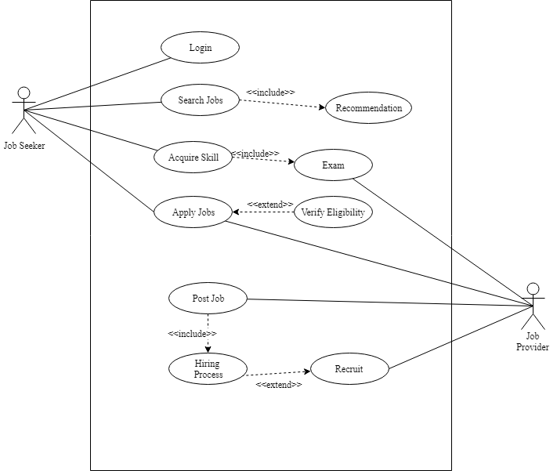
3.2 System Requirement
Functional
Requirement
Job seekers
Job providers
Use-Case
diagram
17

Slide 18
Non-functional Requirements
User friendly
Responsive
Fast
Secure
Support all browsers
18

Slide 19
3.3 Feasibility Study
Schedule Feasibility
Technical Feasibility
Operational Feasibility
Economic Feasibility
19

Slide 20
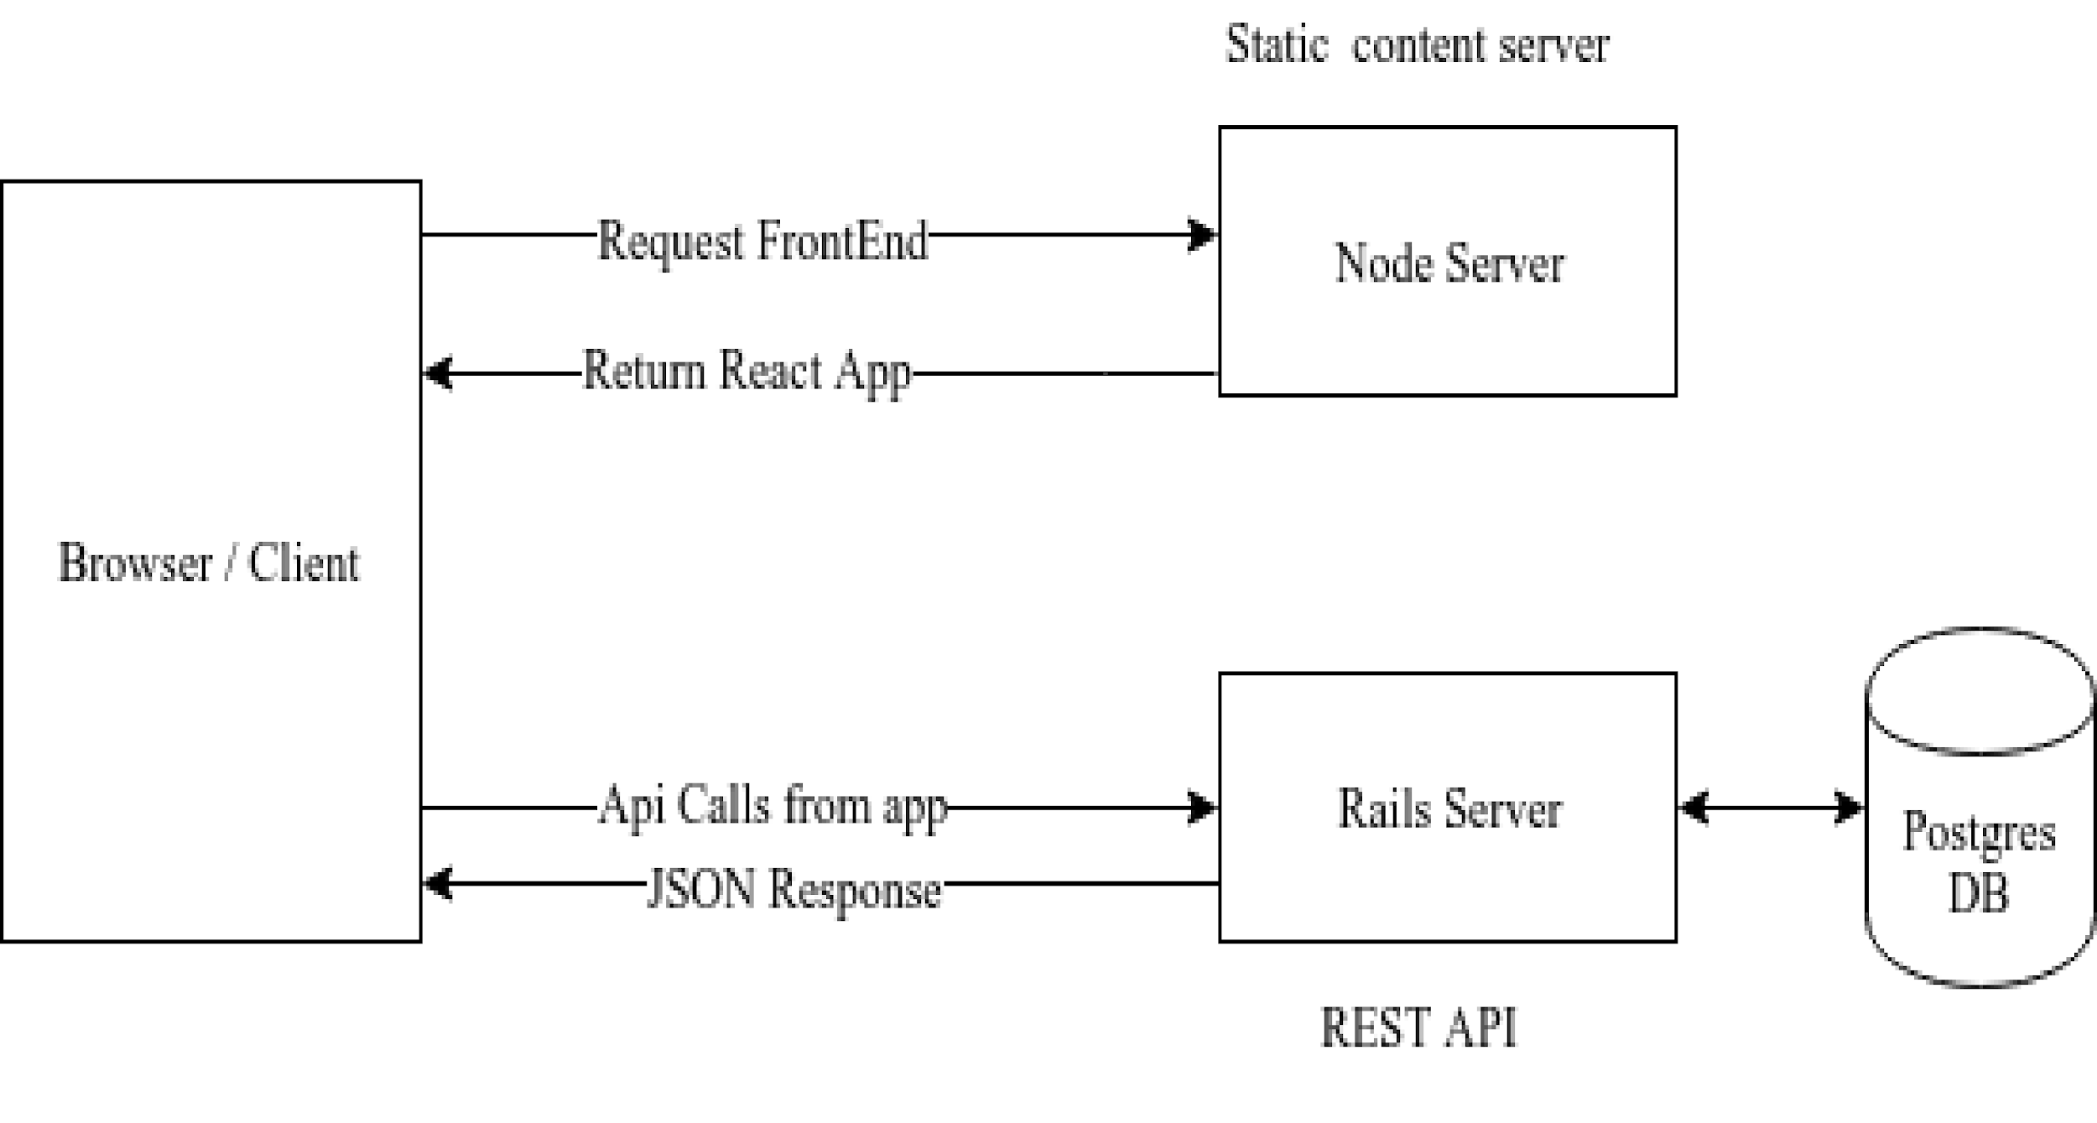
3.4 System Architecture
20

Slide 21
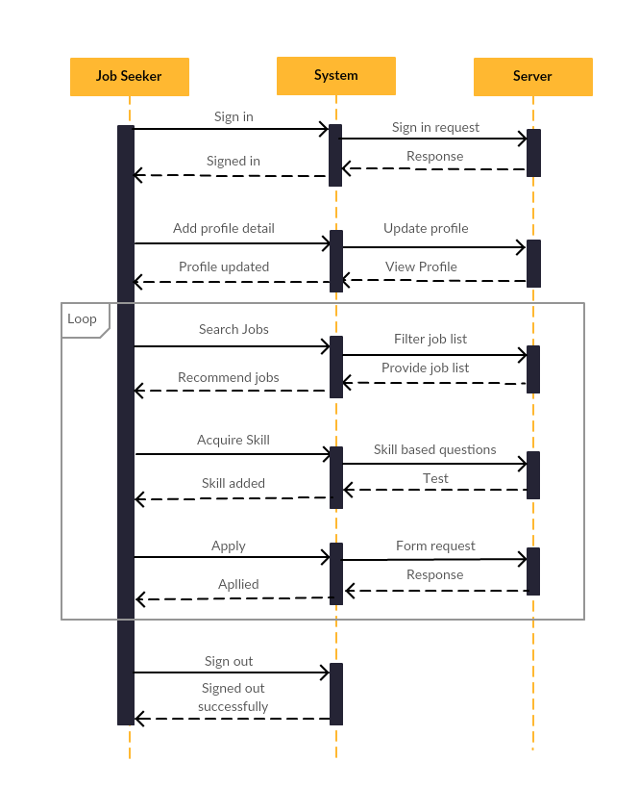
3.5 Sequence
Diagram
Job seeker
sequence
diagram
21

Slide 22
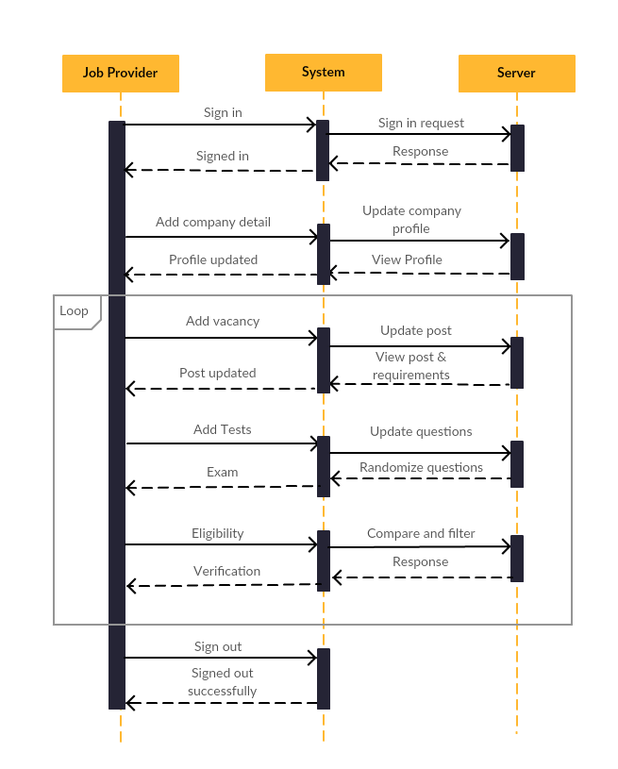
Job Provider
sequence
diagram
22

Slide 23
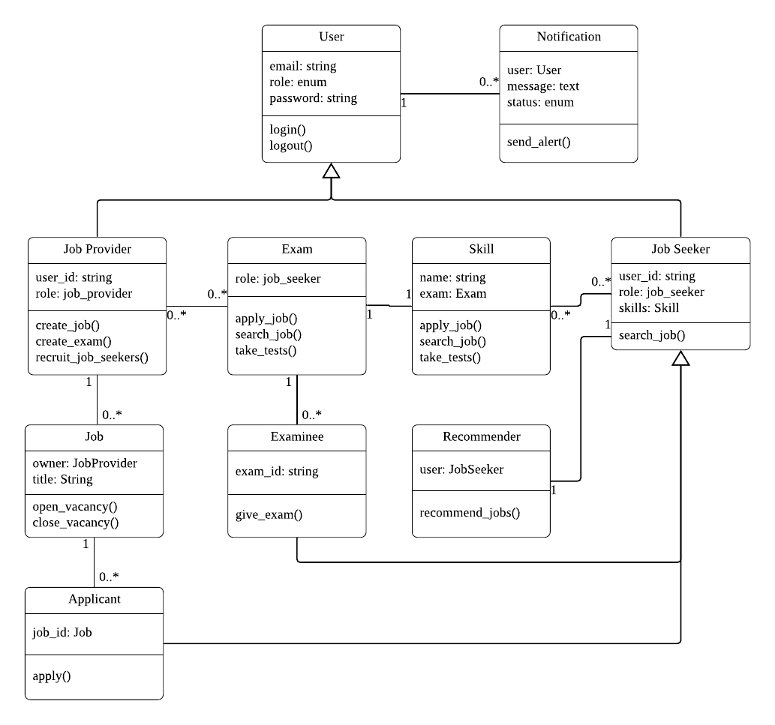
3.6 Class Diagram
23

Slide 24
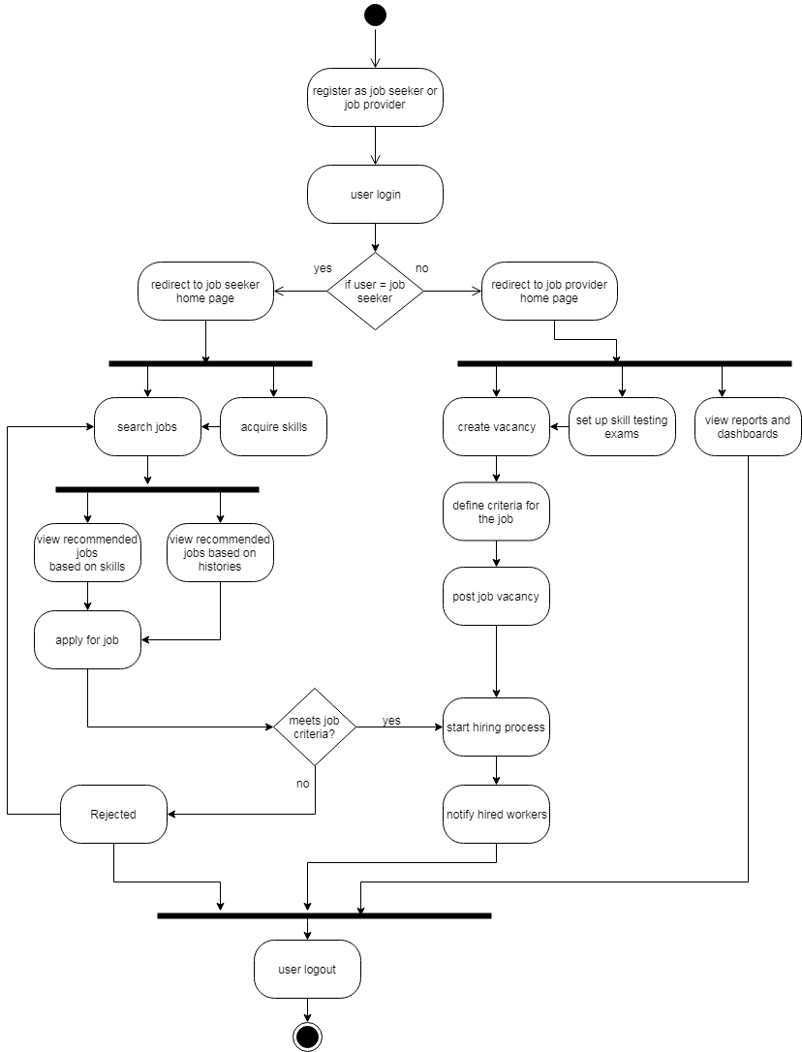
3.7 Activity Diagram
24

Slide 25
CHAPTER 4
IMPLEMENTATION AND TESTING
25

Slide 26
4.1 Implementation
Languages
Operating System
Development Tools
26

Slide 27
4.2 Testing
Unit Testing
Integrated Testing
System Testing
27

Slide 28
CHAPTER 5
CONCLUSION &
RECOMMENDATIONS
28

Slide 29
5.1 Conclusion
successful project
fulfills objectives
29

Slide 30
5.2 Recommendations
Real-time online interview
Update profile dynamically
Learning materials, resources
30

Slide 31
THANK YOU!
31

